Slide 1
Shaping Canada’s NREN
Robin Winsor – Cybera
Alfonso Licata – ORION
Bala Kathiresan – BCnet
Neil McClughan – SRnet
Mark Wolff – CANARIE
Gerry Miller - MRnet

Slide 2
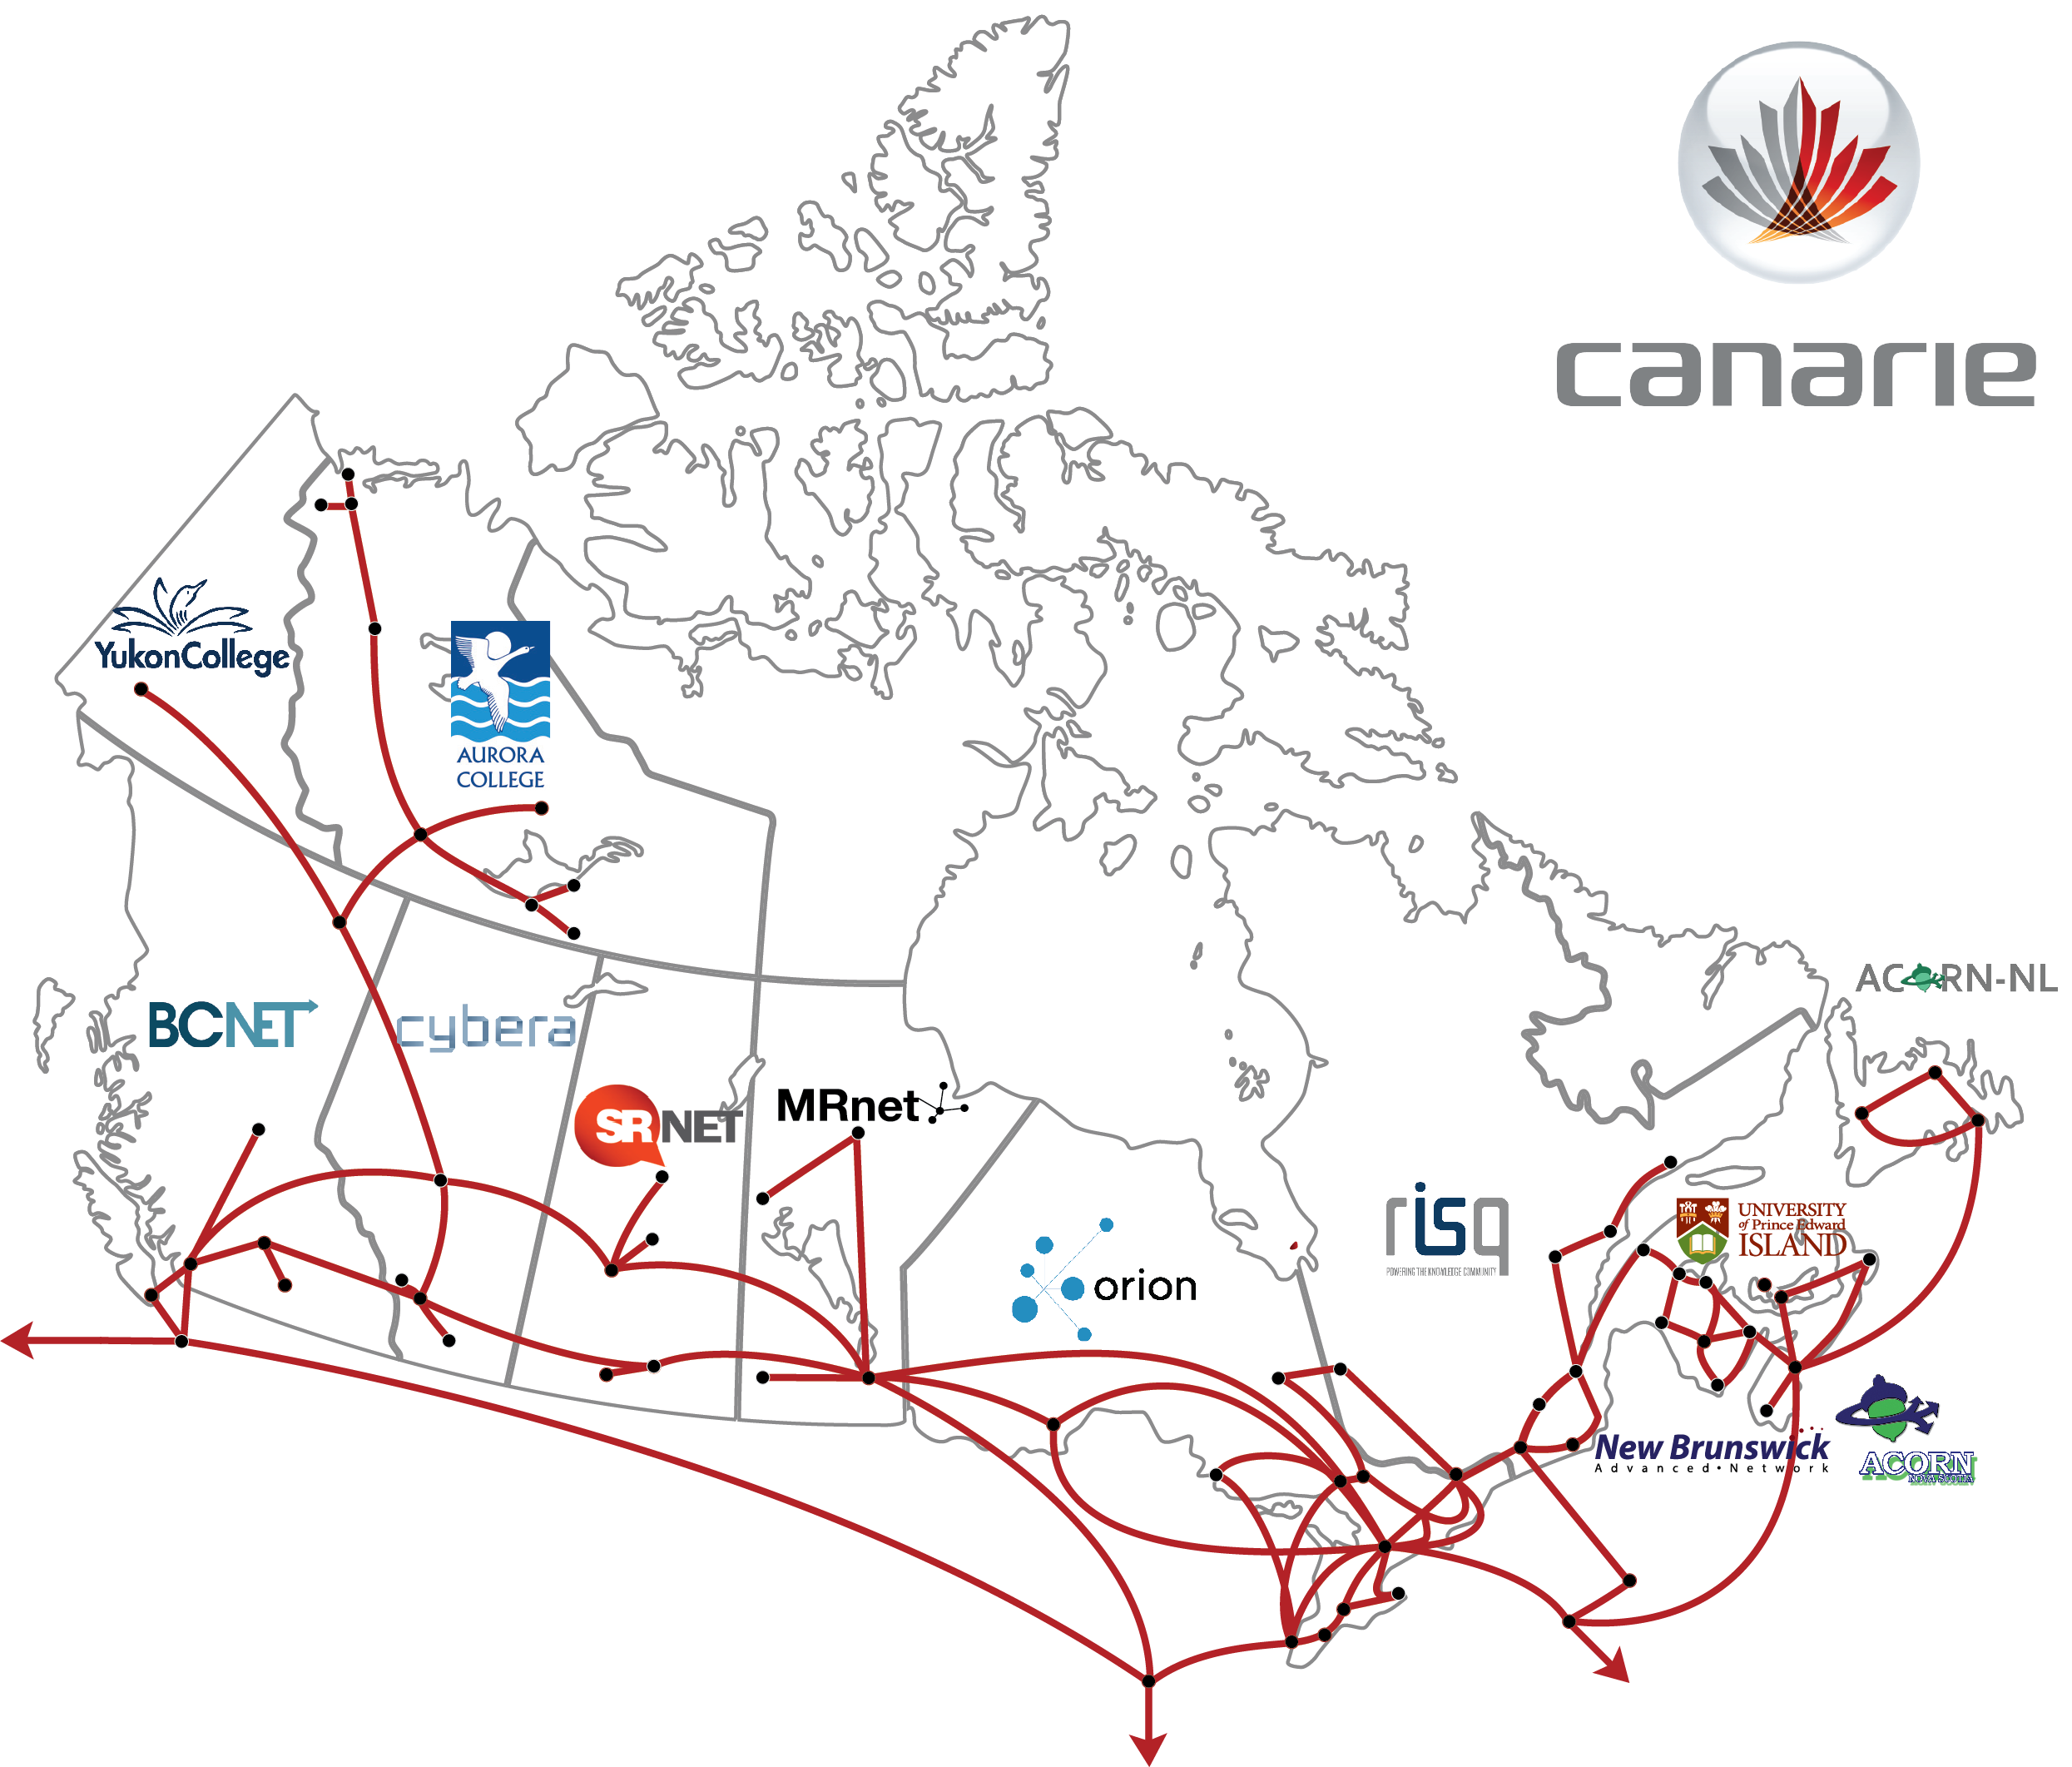
Canada’s National research and education Network
Enables Canadian participation in global research collaborations, connects to 100 global NRENs
Connects over 600 research and education institutions, plus over 5000 K-12 schools
Supports Canadian leadership in data-intensive research and innovation
Millions of Canadians have access to the NREN

Slide 3
INCREASING Demands on the NREN

Slide 4
WHY AN NREN STRATEGY?
The Canadian NREN is an equal partnership of all the regional R and E networks (RANs) in each province and territory, and CANARIE
Increasing demands in the regions and nationally
CANARIE and RAN strategies not previously aligned
Duplication of services/investment
Competing initiatives and priorities
Opportunity to increase effectiveness for stakeholders (R, E & I)

Slide 5
Nren strategic plan
Maps out the evolution of the NREN in three areas:
Services
Organization
Relationships
With a goal of strengthening Canadian leadership in research, education and innovation

Slide 6
Strategic Plan Structure Development
S | O
W | T
Build S, O
________
________
________
________
Mitigate W, T
Services
Organization
Relationships
Improve
Expand
Aspire

Slide 7
Strategic Plan Map

Slide 8
short to medium term priorities
Fast, reliable networking
Ensure a fast, reliable research, education and innovation network that connects all qualified institutions
Communications programs and tactics
Establish a brand and communication strategy to increase communications channels, especially among provincial and federal stakeholder groups
Business processes and practices
Develop, implement and report on an operational plan
Expand service offerings
Distribute services across a national user base

